Slide 1
Coronavirus Tweet Sentiment analysis
CAPSTONE PROJECT
Presented By:
Rajkiran Racha
College Name: Guru Nanak Institutions Technical Campus
Department: Computer Science and Engineering

Slide 2
OUTLINE
Problem Statement
Proposed System/Solution
System Development Approach
Algorithm & Deployment
Result
Conclusion
Future Scope
References

Slide 3
Problem Statement
In the world of social media, especially during the COVID-19 pandemic, people share a lot of thoughts and feelings on platforms like Twitter. But with so many tweets out there, it's hard to tell whether people are feeling positive, negative, or neutral about COVID-19.
This challenge is all about making a smart computer program that can read COVID-19 tweets from Twitter and figure out if they're positive, negative, or neutral. we've hidden the names and usernames to keep things private.The main job is to teach the computer to understand the tweets just like a person would.
This way, we can learn how people are feeling about COVID-19 from what they're saying online. It's important because this information can help health experts, governments, and everyone else understand how people are coping with the pandemic and what needs to be done to help them better.
By tackling these challenges, we hope to gain valuable insights into public sentiment around COVID-19, which can lead to better decisions and actions to tackle the ongoing pandemic.

Slide 4
Proposed Solution
To address the challenge of understanding the sentiment behind COVID-19 tweets, we propose developing a smart computer program known as a sentiment classification model. This model will function as an analytical tool capable of discerning whether tweets express positive, negative, or neutral sentiments towards the pandemic.
The solution will consist of the following components:
1.Data Collection: Collect COVID-19 related tweets from Twitter covering diverse topics.
2.Data Labeling: Manually categorize tweets as positive, negative, or neutral based on sentiment.
3. Model Development: Train a machine learning model using labeled data to recognize sentiment patterns.
4. Evaluation and Refinement: Assess model accuracy on new data and refine iteratively if needed.
5. Deployment: Deploy the model for real-time sentiment analysis of COVID-19 tweets on platforms like Twitter.

Slide 5
System Approach
System Requirements:
Data Collection & Preprocessing: Utilize Twitter API for tweet retrieval. Preprocess tweet text using Pandas for manipulation and NLTK or SpaCy for cleaning and normalization.
Sentiment Analysis Model Building: Develop sentiment classification model using Scikit-Learn for machine learning algorithms. Implement NLP techniques for feature extraction.
Evaluation & Deployment: Evaluate model performance with Scikit-Learn metrics.Deploy model using Flask or Django for integration.
Monitoring & Maintenance: Monitor system performance with Matplotlib and Seaborn.Update model regularly for accuracy and stability.
Main Libraries Used:
Pandas: Data manipulation and aggregation.
Matplotlib and Seaborn: Visualization.
NumPy: Computationally efficient operations
Scikit-Learn: Model training, optimization, and metrics calculation.

Slide 6
Algorithm & Deployment
For predicting sentiment in COVID-19 tweets, we have chosen a set of machine learning algorithms suitable for text classification tasks:
Algorithm Selection:
1. Logistic Regression with Grid Search CV: Logistic Regression is a widely-used linear classification algorithm. With Grid Search CV, we can efficiently tune hyperparameters to optimize its performance for sentiment analysis.
2. Decision Tree Classifier: Decision trees are intuitive models capable of capturing non-linear relationships in data. They are suitable for sentiment analysis tasks where interpretability is important.
3. XGBoost: XGBoost is an ensemble learning algorithm known for its high performance and scalability. It can effectively handle large volumes of text data and capture complex patterns in sentiment expression.
4. K-Nearest Neighbors (KNN): KNN is a non-parametric algorithm that classifies data points based on the majority class among their nearest neighbors. It can be effective for sentiment analysis tasks where local patterns in text data are important.
5. Support Vector Machine (SVM) Classifier: SVM is a powerful algorithm for text classification tasks. It works well with high-dimensional data like text and can capture complex decision boundaries.

Slide 7
Data Input: The input features used by these algorithms include the text of COVID-19 tweets, which serves as the primary source of information for sentiment analysis. Additional features such as tweet metadata (e.g., timestamps, user information) or external data sources (e.g., news headlines, social media trends) may also be considered to enhance the predictive power of the models.
Training Process: During the training process, each algorithm learns to map the input tweet data to corresponding sentiment labels (positive, negative, or neutral). This involves processing the text data to extract relevant features, such as word frequencies or embeddings, and training the model using labeled tweet data. Techniques such as cross-validation and hyperparameter tuning are applied to optimize model performance and ensure robustness.
Prediction Process: Once trained, each algorithm can make predictions for the sentiment of new COVID-19 tweets. The prediction process involves applying the learned decision boundaries or decision rules to the features of unseen tweets to determine their sentiment. Real-time data inputs, such as incoming tweets or updates in the external environment, may be considered during the prediction phase to adapt the models to changing trends or contexts in sentiment expression.

Slide 8
Result
Models Applied: Logistic Regression with Grid Search CV, Decision Tree Classifier, Stochastic Gradient Descent, KNN, SVM, Multinomial Naive Bayes, Bernoulli Naive Bayes Classifier for both Count Vector and TF-IDF Vectorization techniques.
Best Performing Models:
Stochastic Gradient Descent (count vectorizer) achieved the highest accuracy of 80.43%.
Logistic Regression with Grid Search CV (TF-IDF vectorizer) followed closely with an accuracy of 78.86%.

Slide 9
Model Performance Visualization:
To illustrate the performance of the machine learning models for COVID-19 tweet sentiment analysis, we present visualizations and comparisons between predicted and actual sentiment labels. These visualizations provide insights into the accuracy and effectiveness of each model in capturing sentiment trends.
1. Confusion Matrix:
Confusion matrices visualize the distribution of true positive, true negative, false positive, and false negative predictions made by each model.
Each cell in the matrix represents the count or proportion of predictions for a particular sentiment label (positive, negative, neutral) compared to the actual labels.
2. ROC Curve and Precision-Recall Curve:
ROC (Receiver Operating Characteristic) curves plot the true positive rate against the false positive rate for different classification thresholds.
Precision-recall curves visualize the trade-off between precision and recall for varying thresholds, providing insights into the model's ability to correctly classify positive instances while minimizing false positives.

Slide 10
Conclusion
In conclusion, our study focused on analyzing Twitter sentiment during the COVID-19 pandemic, revealing significant shifts in public behavior and the prevalence of misinformation on social media platforms. Our proposed approach, utilizing machine learning and deep learning classifiers with novel feature extraction methods, demonstrated superior performance compared to existing studies, particularly the Logistic Regression with Grid Search CV (count vectorizer) model with an accuracy of 78.28%.
We conclude that the machine is generating the best results for the Logistic Regression with Grid Search CV (count vectorizer) model with an Accuracy of 78.28% followed by the Logistic Regression with Grid Search CV (TF/ID vectorizer) model with an Accuracy of 77.43%.
Also, we observed that no overfitting is seen for the data, and we can deploy this model. Even being in the unprecedented situation of CoVid-19, people's positive sentiments outnumbered negative sentiments. However, negative sentiments also has a significant chunk which various Government agencies, NGOs, etc can use to help boost the morale of the people and thenIn the future ,we can repeat the analysis and compare it with the present sentimental analysis to gauge the impact of the initiatives on the ground.

Slide 11
Future scope
The future scope of this project encompasses several potential avenues for further exploration and enhancement:
Expanded Topic Analysis: Extend sentiment analysis beyond COVID-19 to encompass other essential topics relevant to society, such as government responses to crises, healthcare accessibility, mental health awareness, or environmental concerns.
Advanced Algorithm Exploration: Investigate the application of more sophisticated machine learning and deep learning algorithms to further improve sentiment analysis accuracy and performance on diverse datasets.
Incorporation of Multimodal Data: Integrate multiple data modalities, including text, images, and videos, to capture a more comprehensive understanding of public sentiment and emotions expressed across various social media platforms.
Real-Time Monitoring: Develop systems for real-time monitoring of social media sentiment to enable timely response and intervention by relevant stakeholders during crises or public health emergencies.
Enhanced Misinformation Detection: Enhance the detection and mitigation of misinformation by incorporating natural language processing (NLP) techniques, fact-checking mechanisms, and user credibility assessments into the sentiment analysis framework.

Slide 12
References
Random Forest Regressor - https://scikit-learn.org/stable/modules/generated/sklearn.ensemble.RandomForestRegressor.html
Gradient Boosting Documentation - https://scikit-learn.org/stable/modules/generated/sklearn.ensemble.GradientBoostingClassifier.html
Frontiers | COVID-19 Related Sentiment Analysis Using State-of-the-Art Machine Learning and Deep Learning Techniques (frontiersin.org)
Research papers:
"Corona Virus Outbreak: A Sentiment Analysis" by S. S. Bhatia, A. S. Khandelwal, and A. K. Sharma.
"Sentiment Analysis of COVID-19 Tweets Using Machine Learning Algorithms" by A. R. Khan, M. Islam, and A. R. Khan.
"Sentiment Analysis of Twitter Data for Predicting COVID-19 Trends" by A. Hussain, S. Salah, and M. M. Aboalsamh.

Slide 13

course certificate 1
This certifies that
Rajkiran Racha
has successfully completed the following course
Learn the Fundamentals of Data Science on the IBM Cloud
March 2, 2024
Powered by TCPDF (www.tcpdf.org
)

Slide 14
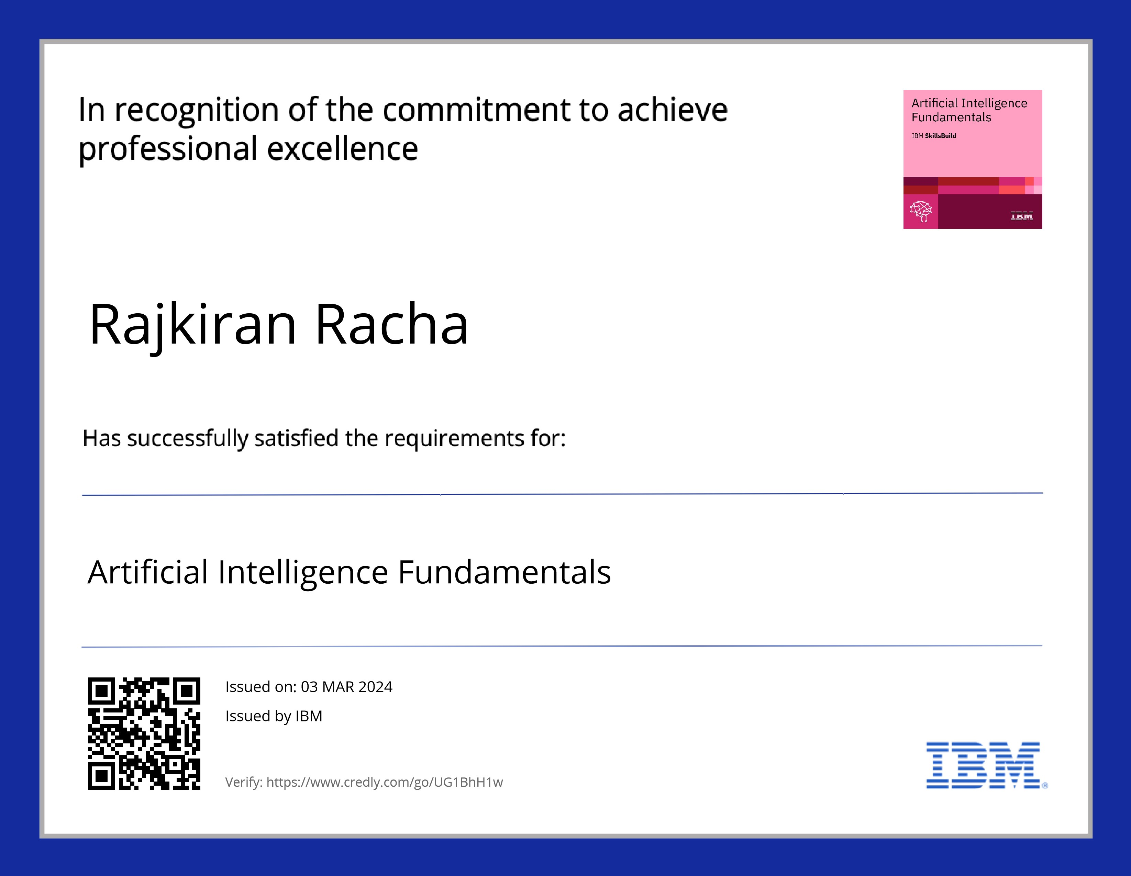
course certificate 2

Slide 15
THANK YOU

